Slide 1
Automating Qualtrics Uploads to LAVA with R
Patrick Callahan
UCSF Memory and Aging Center
09/01/2020
Notes:
Rest of the time will be interactive, and going back and forth between slides and RStudio
Everyone is muted by default, but feel free to ask questions along the way in the chat—note the slide number in your question
I’ll answer these questions at intervals, then open up for conversation at the end of the presentation if you have anything easier to express by talking
Today’s presentation is very much tailored to CRC job duties, particularly when it comes to transferring data from Qualtrics to LAVA. The endgoal, of course, being that you can automate most of that process, and be free to engage in other activities, and have a systematic way of transferring this data such that successors to your positions can maintain workflow continuity.
So in order to understand the process at hand, we’ll first need to discuss the the Qualtrics API, and more generally, what an API is.
With that, what is an API? Well, if you google it, you get a bunch of pretty and not-so-pretty diagrams

Slide 2
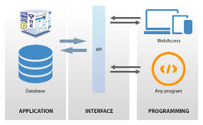

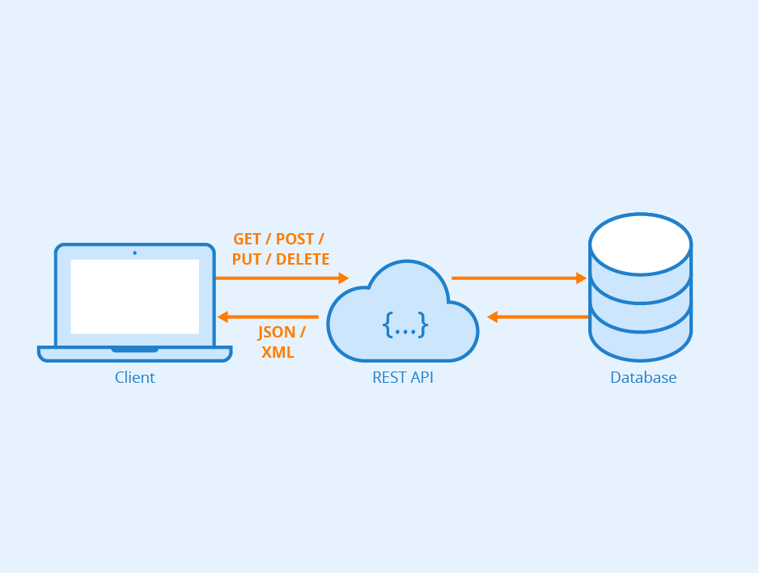
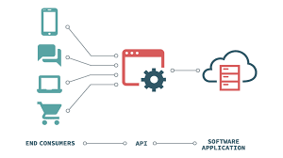
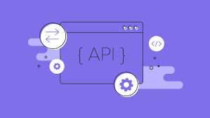
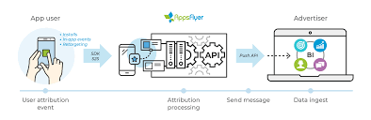
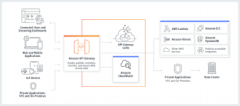
API
Notes:
So if you Google API, you get a bunch of cute little diagrams kind of giving a diagram of an API, computers, and other “stuff” so-to-speak.
Some of these images are simple, some detailed, some useful, and some not really useful
What I like about them is they all ultimately represent a singular idea
An API is essentially an interface between a computer, presumably your computer, and some other set of information or database
(next slide

Slide 3
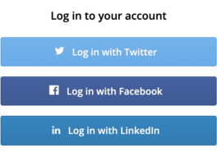
Application Programming Interface
API = Application Programming Interface
“A set of functions and procedures allowing the creation of applications that access the features or data of an operating system, application, or other service.”
Oxford Dictionary
Example: Sign-Up with Google/Facebook/LinkedIn
Notes:
And this idea of interfacing is baked right into the name: API stands for application programming interface
Here’s the Oxford Dictionary definition of it which is a bit obtuse, and I think the idea is best illustrated with an example
If you’ve ever gone to a website that lets you make accounts, you’ve probably seen the links that ask you to sign-up with your Google or Facebook or LinkedIn account
Those websites don’t actually take your log-in information because that’d be a huge security risk.
Instead, if you’re using FaceBook to log-in or sign up for a website, you’re actually allowing the website to check that you’re already logged-in to FaceBook, and then it sends a request to FaceBook for the information it wants from your FaceBook profile like your name, age, gender, phone number, and so on.
In summary, one website asked for information from another website. How does it do this?

Slide 4
HTTP
Hypertext Transfer Protocol
Language for communication between web browsers and data servers
Not all websites are built the same; need standards for retrieving information!
Details irrelevant for this presentation on Qualtrics, but useful to learn HTTP for expanding your skills!
Notes:
So your computer interfaces with websites using HTTP or more recently HTTPS. You see it every time you type a weblink into your address bar in Google Chrome!
It actually means you’re submitting a Hypertext Transfer Protocol request to that website
And so HTTP is just a language for communication between web browsers, computers, and servers
It’s useful because it provides a standard language to draw information from websites that might have their data structured in different ways.
The details otherwise aren’t relevant, but I think it’s good to understand that every time you want to log-in to a site or draw data programmatically from somewhere, it relies on HTTP
Ok, enough boring details. What does this all have to do with Qualtrics?

Slide 5
Qualtrics API
Systematically download survey data!
Notes:
Well, Qualtrics has an API! Their API let’s you easily access and download all of the data from your Qualtrics account
By all of your data, I particularly am talking about the data from any and all surveys available in your account
No need to log-in to Qualtrics via MyAccess every and anytime you need to download more data from a survey so that it can be uploaded to LAVA or wherever else your lab is storing
The API essentially allows you to automate your download process, and ideally any cleaning steps, into a single script.
So why should you care about this automation?

Slide 6
Why automate?
Speed and convenience
Reduce mistakes in process
Consistent procedure and documentation for future CRCs
Notes:
Well, it’s just faster and convenient to press a single button to download your data!
Moreover, a script that does everything for you greatly reduces the risk of making mistakes in the cleaning process
And, because I know the lack of SOPs and manuals plagues many groups at the MAC, automating this process allows for a clear and consistent procedure that can be passed along to future staff

Slide 7
What can we automate?
Downloads of data from Qualtrics
Any requisite data cleaning
Preparing column names for LAVA
E.g. adding “SKIP” to column names
Notes:
So what can easily be automated out of the process of Qualtrics data to LAVA?
Well, we can download the data
We can clean the data by removing missing values and performing any calculations that might need to be done
And, assuming you’re familiar with LAVA import definitions, we can also prep the data by removing columns or appending “SKIP” to columns that are skipped in the import process

Slide 8
What can’t we automate?
Handling updates to the surveys
Will need to adjust R processing scripts if you change survey names or add columns!
Final step: uploading data via LAVA import tools will still need to be done by hand
Takes <2 minutes!
Notes:
Important to note that if you make changes to your survey, you might also need to make changes to the script but this would go hand-in-hand with updating all of the SOPs you should have. Right?
And, as of right now, we can’t actually automate the final step of moving the file into LAVA, but using the LAVA import tool manually only takes a handful of minutes assuming you’ve already set up an import definition
With that, we’ll jump into the process

Slide 9
What you’ll need
R + RStudio
{tidyverse}, {qualtRics} and {keyringr} packages for R
Encouraged: Git + GitHub account to track changes in your scripts
Notes:
Unsurprisingly, you’ll need the R software and I recommend RStudio
You’ll want to download the three packages listed here.
And I encourage people to use Git and GitHub to track changes in scripts. I would particularly encourage using a version control system for scripts like this that will be managing data so there’s always a history of how your data was managed
I’ve covered all of these topics in some of my previous sessions, but you can also Google for quick tutorials on downloading R/Rstudio, and installing the R packages above in case you’ve never used it.
Assuming you have all of these installed, what do we do?

Slide 10
Process Overview
Set up Qualtrics account information on your computer
1
GET data from your tests using the Qualtrics API
2
Clean and upload data to LAVA
3
Notes:
There are 3 major steps in this tutorial

Slide 11

1. Qualtrics Account Info
Gather your Qualtrics API Token from your account
Press -> Account Settings -> Qualtrics IDs -> copy the API Token
Store API Token in your OS password manager
KeyChain on Mac
Recommend labeling it “Qualtrics_API_Key” or similar

Slide 12
2. GET Data from Qualtrics
Establish access credentials in your R script
qualtRics::qualtrics_api_credentials(api_key = keyringr::decrypt_kc_pw("Qualtrics_API_Key"), base_url = "ucsf.co1.qualtrics.com")
Will be prompted to allow access to KeyChain; enter your computer password
Access complete list of your surveys and IDs
qualtrRics::all_surveys() %>% View()
Query surveys for their data by ID
qualtRics::fetch_survey(surveyID = “”, force_request = T)
Notes:
For those familiar with HTTP requests, these are all just a bunch of GET requests

Slide 13
3. Clean and Upload: Existing Import Definitions
Add “SKIP:” to column names where needed
dplyr::rename_at(vars(…), ~paste0(“SKIP:”,.))
Perform other data cleaning as needed
Turn file into a .CSV, and upload through LAVA
readr::write_csv(path = “”, na =“”)
For short-use files like this, I usually set path to “~/Desktop/file_name.csv”

Slide 14
3. Clean and Upload: Create a New Import Definition
Recommendation: drop columns not uploaded to LAVA rather than using “SKIP:” feature
Use dplyr::select() to select only the columns you want to upload
Work with MAC Tech Team to create a new import definition
Complete data cleaning and CSV writing mentioned in previous slide

